Slide 1

Source
Notes:
Did you know? In the first month after the release of Squid Game subscribers spent around 1.65bn hours watching it, equivalent to 190,000 years.
This fact alongside our bingeing habits, led us to decide our topic for our exploratory data analysis.

Slide 2













Evolving Landscapes of Television:
An Analytical Dive into TV Show Trends on Netflix
Images - Netflix

Slide 3






Who’s presenting?
Ammarah
Eoghan
Nana
Nida
Safa
MANAGE PROFILES

Slide 4
Research Questions
1
How has Netflix’s content strategy for TV shows evolved?
2
What are the factors that determine a show’s success/popularity?
3
Has there been a shift in target audience demographics?
4
Did the pandemic change tastes in favour of reality TV?
Notes:
This project is designed to provide a detailed understanding of the dynamics of television content on Netflix. The study aims to offer valuable insights for content creators, media strategists, and streaming service analysts.

Slide 5

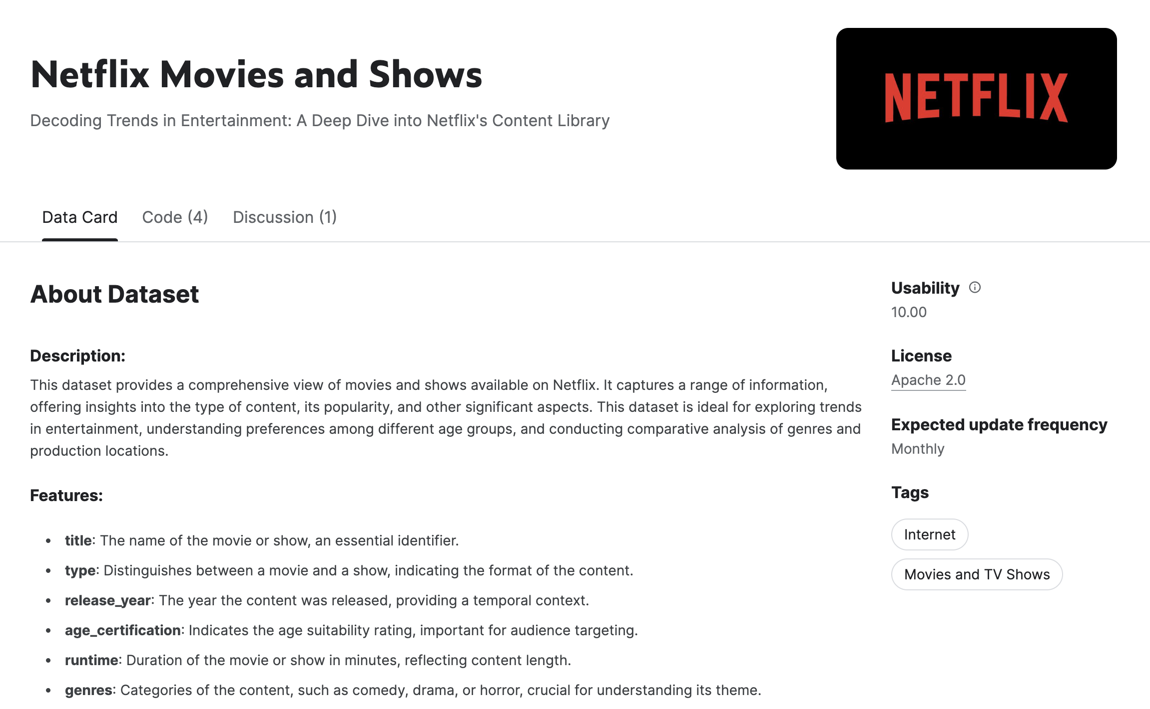
The Dataset
Notes:
Our primary dataset was from Kaggle and it provided a comprehensive view of both movies and shows – we however focused only on shows.

Slide 6
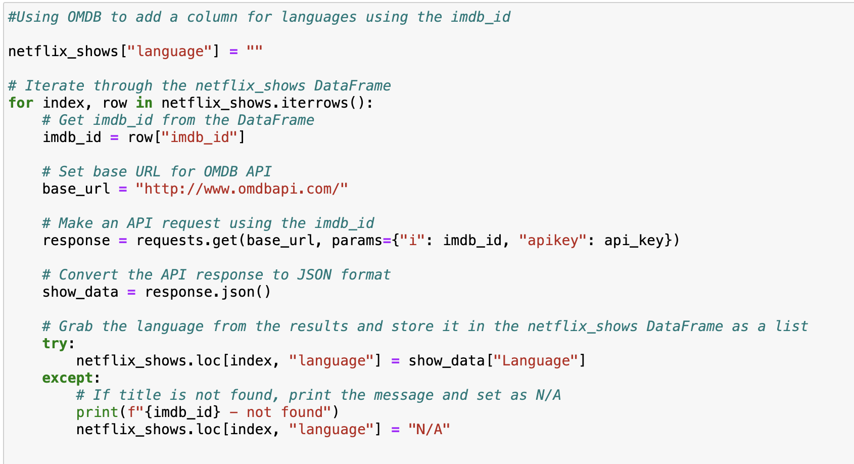
OMDB API to supplement the primary dataset
Notes:
The one element missing from our dataset was the languages the shows were released in so we used the OMDB API to add that information – the relevant code should be visible on your screens. The final dataset contains 1,670 data points, each representing a different show on Netflix, with details such as the title, release year, age certification, language, genres, IMDb score, and IMDb votes.

Slide 7
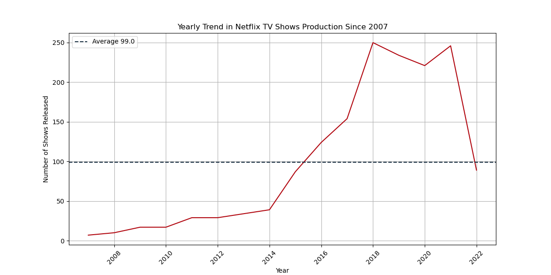

1
How has Netflix’s content strategy for TV shows evolved?
Notes:
Yearly Trend in Netflix TV Shows Production Since 2007: The graph demonstrates a significant investment in original content by Netflix over the years, particularly from 2015 leading up to the peak. This trend aligns with Netflix’s strategy to expand its library of original content as a differentiator in the competitive streaming market. The sharp decrease in the most recent year could be indicative of various factors such as strategic realignment, budget constraints, changes in consumer preferences, or external factors such as the global COVID-19 pandemic.

Slide 8
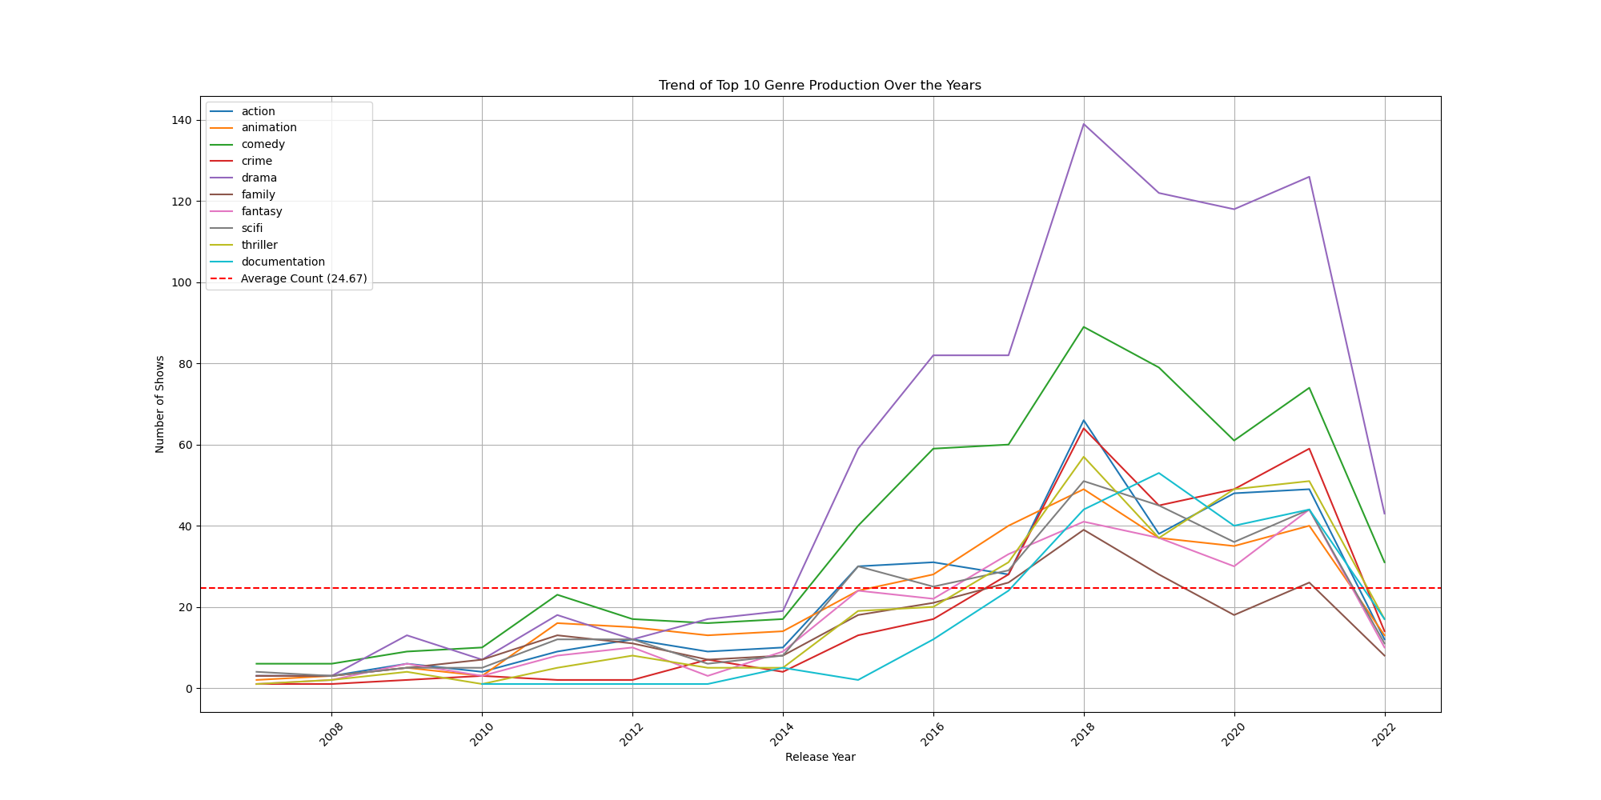
1
How has Netflix’s content strategy for TV shows evolved?
Notes:
Trend of Top 10 Genre Production Over the Years: We identified growth patterns of each genre, with drama and comedy seeing substantial increases. There is a general upward trend for all top genres, indicating an increase in diversity of content.

Slide 9
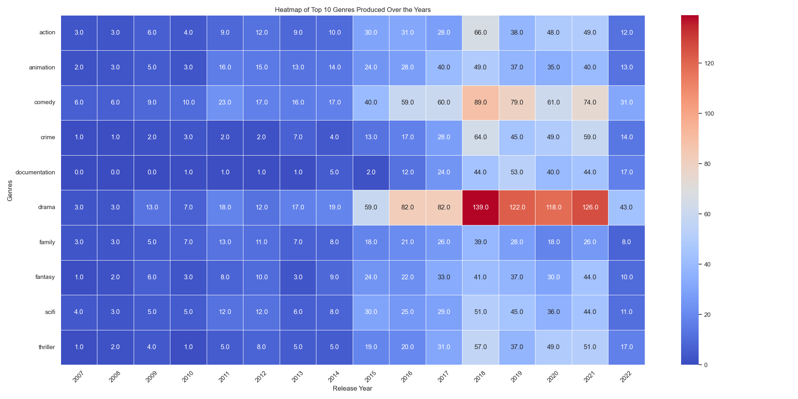
1
How has Netflix’s content strategy for TV shows evolved?
Notes:
Heatmap of Top 10 Genres Produced Over the Years: The heatmap visualizes the production counts of the top ten genres on Netflix from 2007 onwards. The heatmap provides a colour-coded representation of the number of shows produced in the top genres over time. Darker colours represent a higher production count.
Drama, comedy, and action genres dominate the production, with the drama genre experiencing the highest production numbers, especially in recent years.
This heatmap is valuable for understanding how Netflix has varied its content production over time, focusing on certain genres that align with its strategic goals or viewer demand trends. It also illustrates the platform's response to the evolving entertainment landscape.

Slide 10
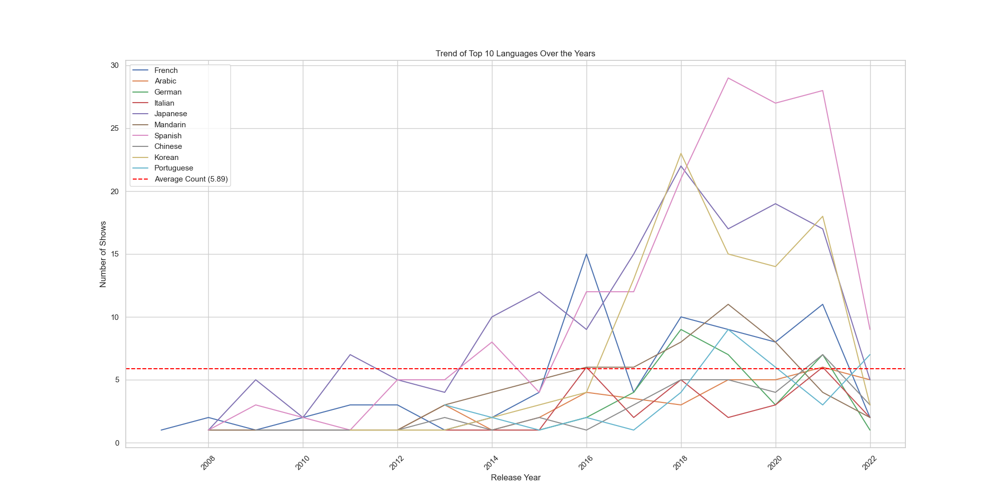
1
How has Netflix’s content strategy for TV shows evolved?
Notes:
Peaks in productions of certain languages like Japanese and Korean reflect a successful penetration into these markets, capitalizing on the global popularity of K-dramas and anime.

Slide 11
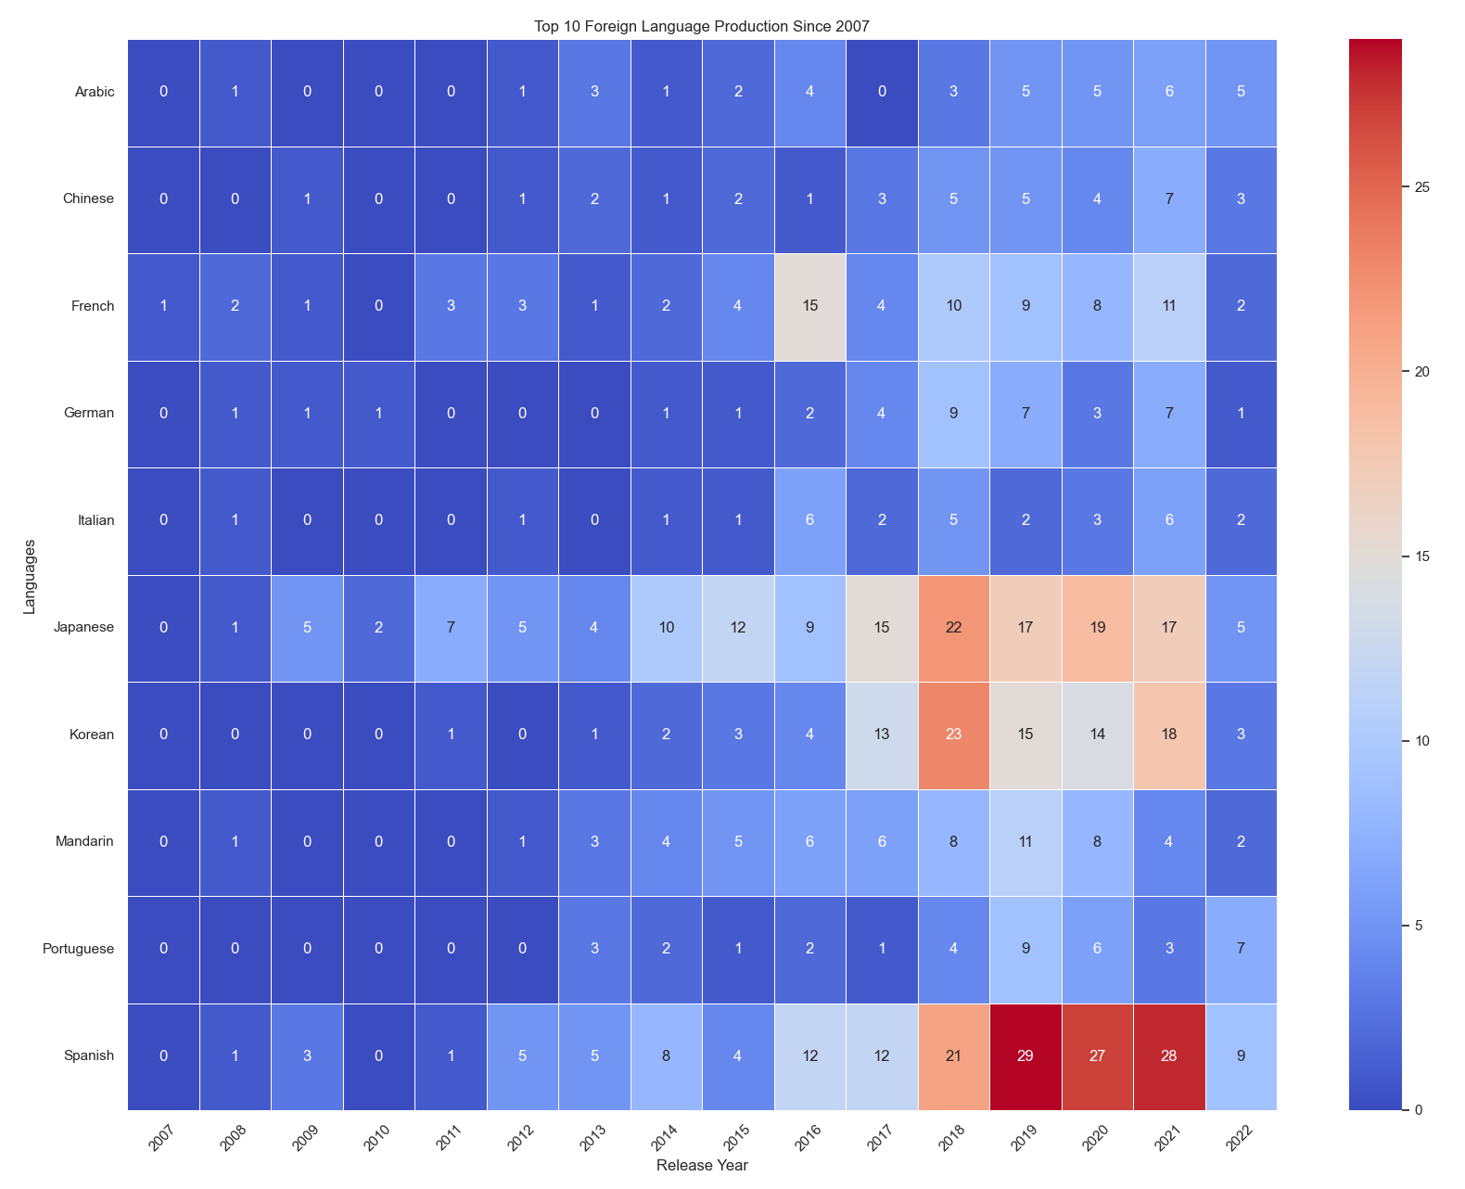
1
How has Netflix’s content strategy for TV shows evolved?
Notes:
The heatmap shows the trend in the top foreign languages, with a noticeable increase in production in Japanese, Korean, and Spanish, indicating a strategic focus on these markets.
The production of content in non-English languages has also been increasing, with a particularly noticeable growth in shows in Japanese, Korean, and Spanish, reflecting a diversification in Netflix's offerings.
There is a sharp decrease in both the production of TV shows across genres and languages in the last year shown on the graphs, which may indicate a shift in strategy, market conditions, or external factors affecting production.

Slide 12
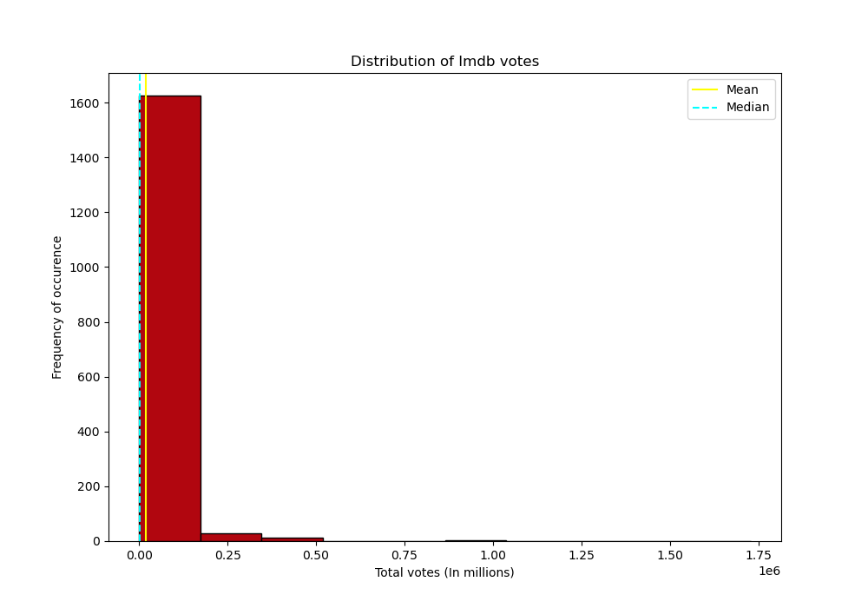
2
What are the factors that determine a show’s success/popularity?
Notes:
Distribution of Total Votes (In millions): This histogram displays the distribution of IMDb votes for different shows or movies. The x-axis represents the total votes in millions, and the y-axis represents the frequency of occurrence. The mean and median of the distribution are indicated by horizontal lines. The distribution is heavily skewed to the left, showing that most shows have a relatively small number of votes, with very few shows receiving votes in the millions.

Slide 13
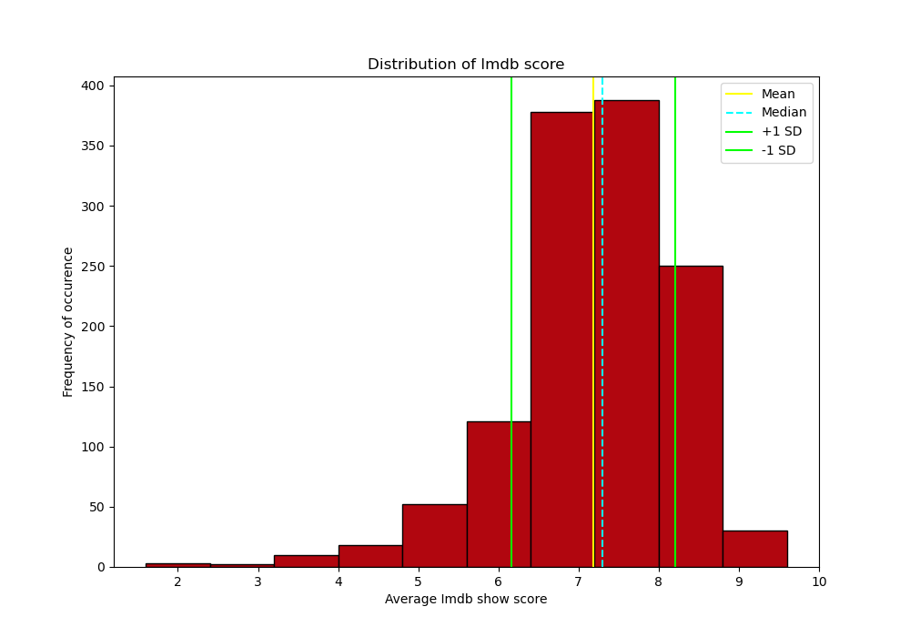
2
What are the factors that determine a show’s success/popularity?
Notes:
Distribution of IMDb Scores: This histogram shows the distribution of IMDb scores for various shows or movies. The scores range from 2 to 10. The mean and median are indicated, along with lines representing one standard deviation above and below the mean. The distribution appears to be roughly normal, centered around a score of 6 to 7.

Slide 14
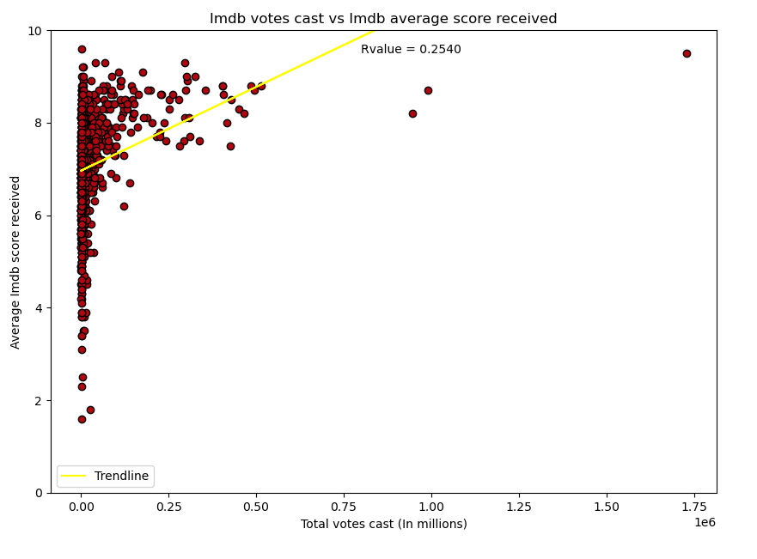
2
What are the factors that determine a show’s success/popularity?
Notes:
Scatter Plot of Votes vs. Scores: This scatter plot presents the relationship between the total number of votes a show receives and its IMDb score. Each point represents a show, with the x-axis indicating total votes and the y-axis representing the score received. A trendline is added to indicate the direction of the relationship, and an R-value is provided to denote the strength and direction of the correlation. The R-value suggests a weak positive correlation, indicating that shows with more votes tend to have slightly higher scores.

Slide 15
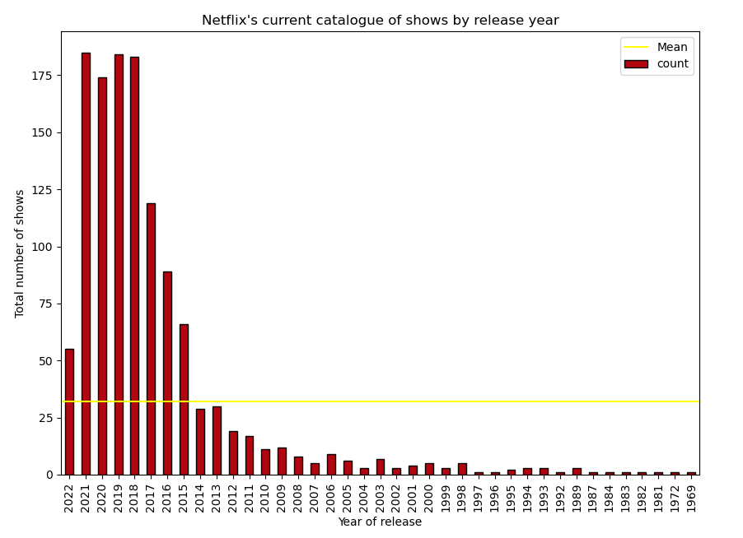
2
What are the factors that determine a show’s success/popularity?
Notes:
Total Number of Shows by Year of Release: This bar chart indicates the number of shows released each year. The x-axis represents the year of release, and the y-axis represents the total number of shows. A horizontal line indicates the mean count of shows released per year. The chart shows a decline in the number of shows released in more recent years.

Slide 16
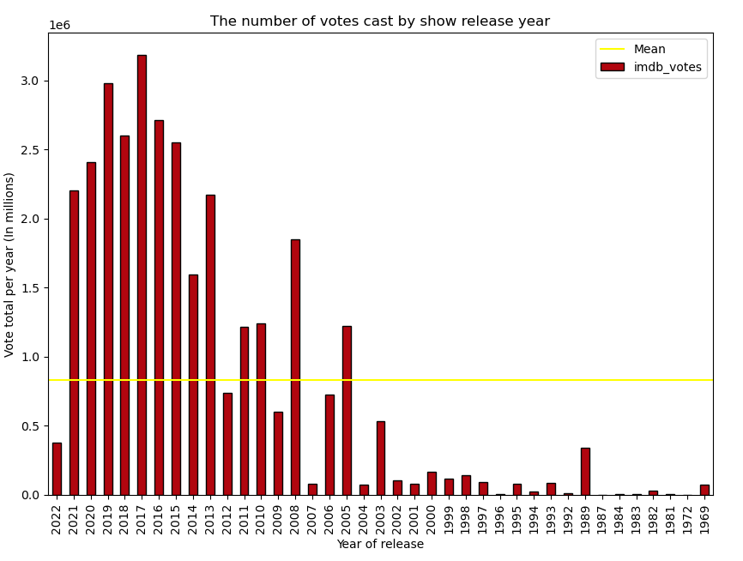
2
What are the factors that determine a show’s success/popularity?
Notes:
Total Number of Votes per Year: This bar chart shows the total number of IMDb votes received by shows per year of release. The x-axis represents the year of release, and the y-axis represents the total votes per year. A horizontal line indicates the mean number of votes per year. There is a noticeable decline in the number of votes in the most recent years shown.
Overall Summary:
The distribution of votes is highly skewed, with a large number of shows receiving few votes and a small number of shows receiving a high number of votes.
The distribution of scores is roughly normal with a mean score around 6 to 7.
There is a weak positive correlation between the number of votes and the score received, suggesting that more popular shows (with more votes) tend to have higher scores.
Both the number of shows and the total number of votes have declined in recent years according to the last two graphs. This could suggest a shift in viewing habits, a change in the number of shows being produced or rated, or other market dynamics.

Slide 17
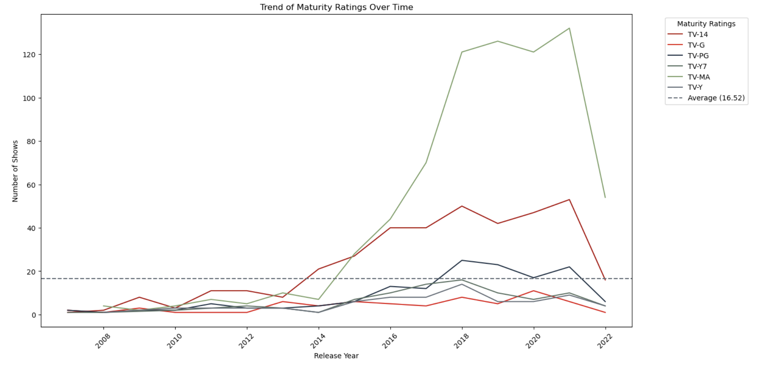
3
Has there been a shift in target audience demographics?
Notes:
Trend of Maturity Ratings Over Time: TV-MA (Mature Audience) shows have seen a significant increase, peaking around 2019, which suggests a strong trend toward content aimed at adult audiences. TV-14 (suitable for viewers over 14) also shows an increasing trend but less pronounced than TV-MA.
The average line indicates that both TV-MA and TV-14 productions are above the average number of shows produced, which shows a clear inclination towards these categories.

Slide 18
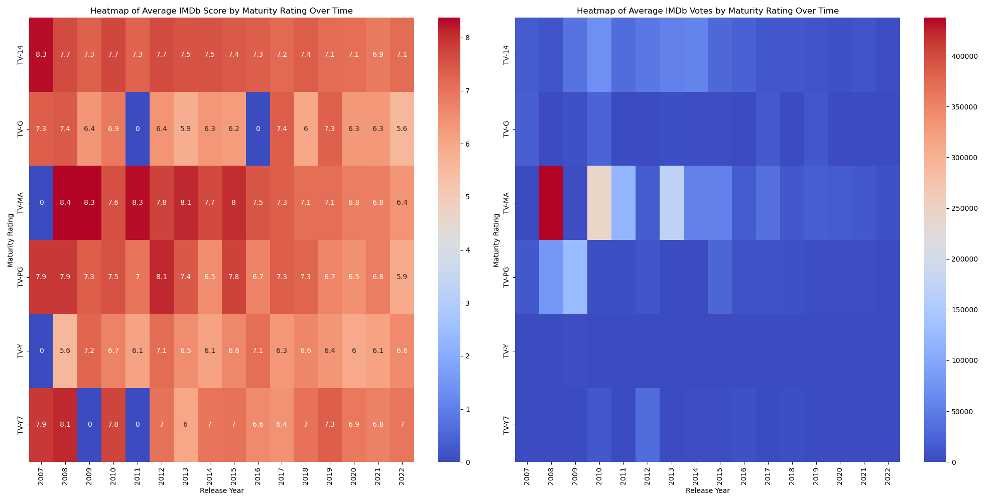
3
Has there been a shift in target audience demographics?
Notes:
Heatmap of Average IMDb Score by Maturity Rating Over Time & Heatmap of Average IMDb Votes by Maturity Rating Over Time: The heatmaps provide a visual representation of the average IMDb scores and votes across different maturity ratings over time. The heatmap for scores shows moderate to high scores across all maturity ratings without a clear pattern favouring one rating over another. The heatmap for votes shows more pronounced hotspots, especially for TV-MA content in recent years, indicating higher engagement.

Slide 19
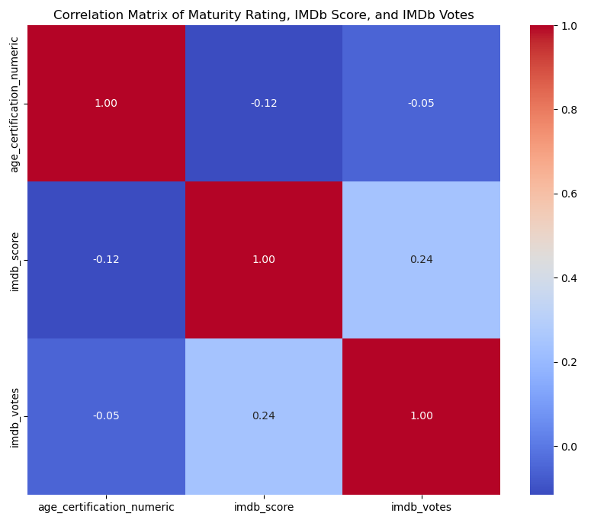
3
Has there been a shift in target audience demographics?
Notes:
Correlation Matrix of Maturity Rating, IMDb Score, and IMDb Votes: The matrix displays the correlation between age certification numeric values, IMDb scores, and votes. There is a very weak negative correlation between maturity rating and IMDb score, and a weak positive correlation between IMDb scores and votes. This suggests that higher-rated content does not necessarily score better, but shows that higher scores do tend to receive more votes.
Overall Summary:
There has been variability over the years in the number of shows produced across different maturity ratings, with some years seeing peaks in production for certain ratings.
The IMDb scores vary by maturity rating, suggesting that audience perception of quality may be associated with the intended audience age group.
The number of votes, which can be an indicator of popularity, also varies across maturity ratings and over time.
The heatmaps allow for a detailed comparison of how scores and votes change over time within each maturity category.
The correlation matrix suggests that there are only weak relationships between the maturity rating of a show, its IMDb score, and the number of votes it receives, indicating that maturity may not be a strong predictor of a show’s perceived quality or popularity.

Slide 20
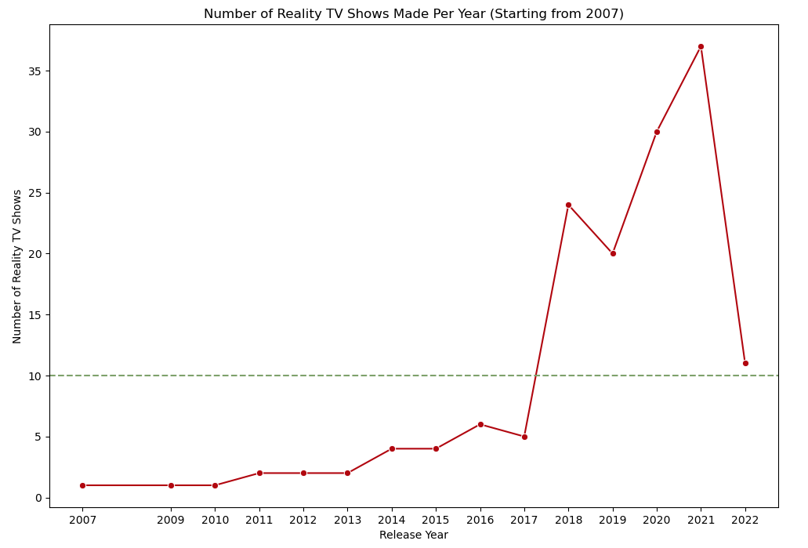
4
Did the pandemic change tastes in favour of reality TV?
Notes:
Number of Reality TV Shows Made Per Year (Starting from 2007): This line graph indicates the number of reality TV shows produced each year from 2007 onwards. There is a notable peak in 2020, which could be associated with the onset of the COVID-19 pandemic. The trend shows an increase from previous years, suggesting a rise in the production of reality TV shows during the pandemic. However, in 2022, there is a sharp decline, indicating that the increase was not sustained post-pandemic.

Slide 21
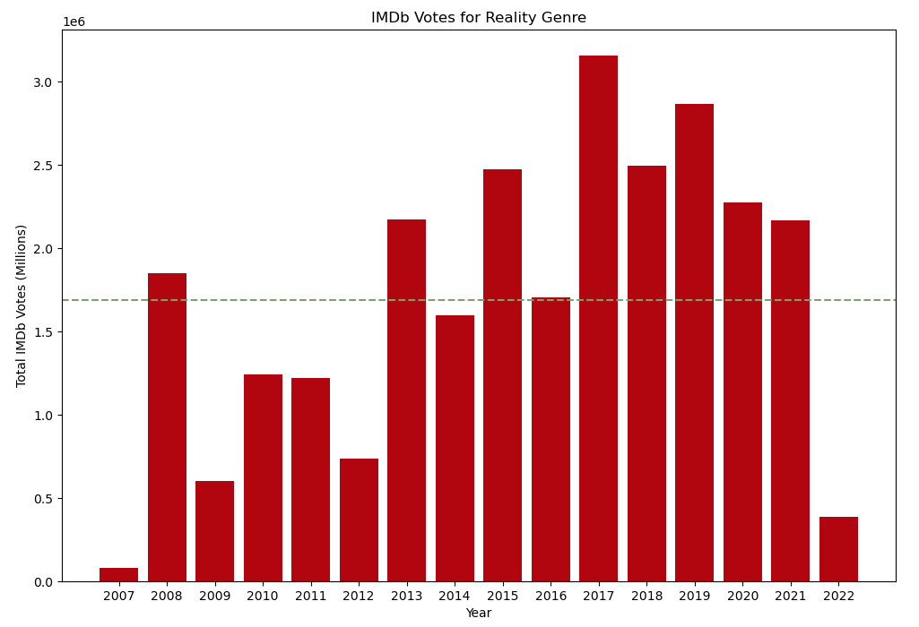
4
Did the pandemic change tastes in favour of reality TV?
Notes:
IMDb Votes for Reality Genre: This bar chart presents the total IMDb votes for reality TV shows per year. There is a peak in 2020, supporting the previous chart's implication of the increased popularity of reality shows during the pandemic. The votes are significantly higher compared to other years, including the preceding and following years. This suggests that while production dropped in 2022, viewer engagement in terms of votes remained relatively high.

Slide 22
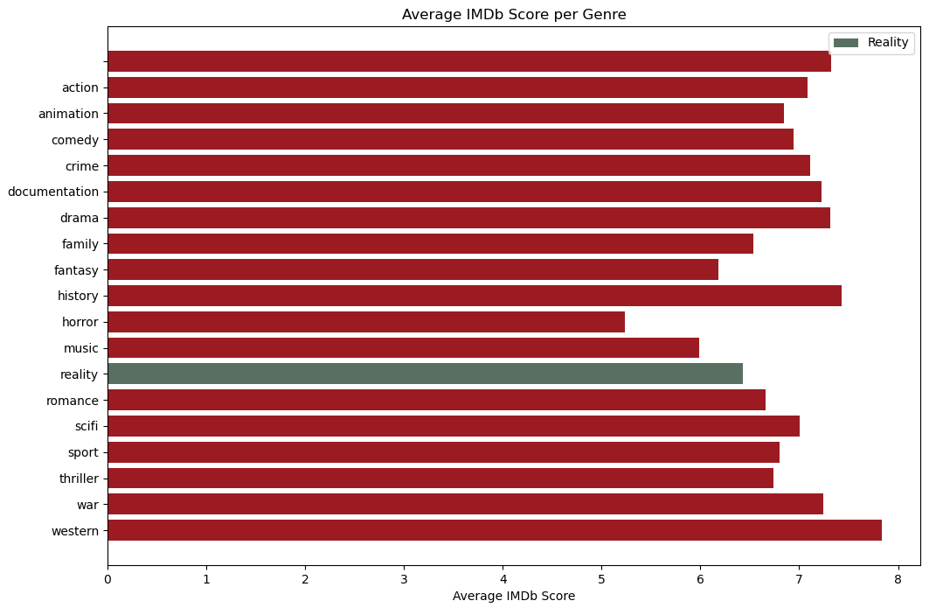
4
Did the pandemic change tastes in favour of reality TV?
Notes:
Average IMDb Score per Genre: The horizontal bar chart compares the average IMDb scores across various genres, with a particular emphasis on reality TV, which has one of the lowest scores. This implies that while reality TV may have a solid viewer base, it does not necessarily translate into high critical acclaim or high scores on IMDb.
Overall Summary:
Sci-fi and action genres appear to engage viewers the most, leading to higher average IMDb votes.
There has been a significant rise in the production of reality TV shows, especially around 2021.
While the number of IMDb votes for reality shows has been increasing, indicating popularity, the average IMDb score for reality shows is lower compared to other genres.
The data suggests that while reality TV shows may be widely watched and voted on, they tend to have lower ratings, which may reflect critical reception or viewer satisfaction.

Slide 23

Notes:
Conclusions
Diversification and Growth
Netflix has significantly diversified its content offering, with a particular increase in drama, comedy, and action genres. This reflects a content strategy designed to cater to a broad range of viewer interests and demographics.
Global Expansion
There is a clear trend toward producing content in multiple languages, with notable increases in Japanese, Korean, and Spanish productions. This indicates a strategic move to capitalize on global market trends and the popularity of certain international genres, such as K-dramas and anime.
Mature Content
There has been a growth in TV-MA-rated content, suggesting a focus on adult-oriented programming. This aligns with a broader trend in the streaming industry to produce more sophisticated and mature narratives.
Reality TV During Pandemic
Reality TV saw a surge in production and viewer engagement during the pandemic, which did not sustain post-pandemic, suggesting that this genre's growth was likely an anomaly due to the unique circumstances of the global pandemic.
Viewer Engagement vs. Critical Acclaim
While reality TV shows have had solid viewer engagement, they do not necessarily receive high critical acclaim, indicating a dichotomy between popularity and perceived quality.
Content Quality and Popularity There is a weak positive correlation between the number of IMDb votes and scores, suggesting that while higher-rated shows tend to be more popular, there are also many high-quality shows that do not receive as many votes.
Future Implications for Exploratory Data Analysis
Content Strategy Adjustments
Netflix may need to continue adjusting its content strategy to balance the creation of broadly appealing content with the production of niche shows that cater to specific audience segments.
Investment in Quality
The data suggests that investing in high-quality content can lead to better viewer engagement. Netflix might need to consider how to leverage this relationship further, perhaps by directing more resources toward shows with higher engagement potential.
Post-Pandemic Content Planning
Given the drop in reality TV production post-pandemic, Netflix could explore whether other genres might fill the void or whether there are new emergent genres that could capture audience attention in the longer term.
Understanding Audience Behaviour
The increase in international content and mature ratings points to changing viewer preferences. Netflix might benefit from deeper audience behaviour analysis to understand the evolving tastes and how they correspond to global trends.
Long-Tail Content Value
Considering the right-skewed distribution of votes, Netflix could evaluate the long-tail value of content that does not initially receive high engagement but maintains steady viewership over time.
Sustainability of High Production Rates
The recent decline in the number of shows produced may reflect market saturation, increased competition, or strategic realignment. Understanding this trend will be crucial for planning future production volumes.
In summary, the exploratory data analysis points to a dynamic and evolving content landscape for Netflix. The insights gained from this data can guide strategic decisions to enhance viewer engagement, expand global reach, and adjust content offerings to match audience preferences and emerging market trends.

